Slide 1
Application Layer Chapter 7
DNS – Domain Name System
Electronic Mail
The Web
Streaming Audio and Video
Content Delivery
Revised: August 2011
Notes:
Gray units can be optionally omitted without causing later gaps

Slide 2
The Application Layer
Uses transport services to build distributed applications
Application
Transport
Network
Link
Physical

Slide 3
Evolution of Internet Applications
Always changing, and growing …
???
Traffic
Web (Video)
P2P (BitTorrent)
Web (CDNs)
Web (HTTP)
News (NTTP)
Email
Email (SMTP)
File Transfer (FTP)
Telnet
SSecure Shell (ssh)
1970
1980
1990
2000
2010

Slide 4
Evolution of Internet Applications (2)
For a peek at the state of the Internet:
Akamai’s State of the Internet Report (quarterly)
Cisco’s Visual Networking Index
Mary Meeker’s Internet Report
Robust Internet growth, esp. video, wireless and mobile
Most traffic is video, will be 90% of Internet in a few years
Wireless traffic will soon overtake wired traffic
Mobile traffic is still a small portion (15%) of overall
Growing attack traffic from China, also U.S. and Russia

Slide 5
DNS – Domain Name System
The DNS resolves high-level human readable names for computers to low-level IP addresses
DNS name space »
Domain Resource records »
Name servers »

Slide 6
Before the DNS – HOSTS.TXT
Directory was a file HOSTS.TXT regularly retrieved for all hosts from a central machine at the NIC (Network Information Center)
Names were initially flat, became hierarchical (e.g., lcs.mit.edu) ~85
Neither manageable nor efficient as the ARPANET grew …

Slide 7
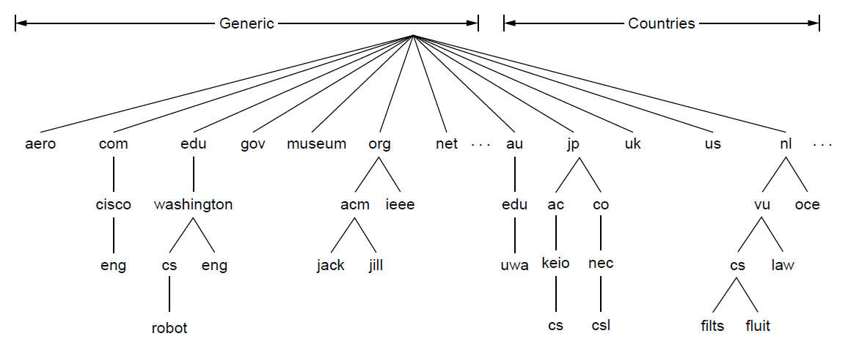
The DNS Name Space (1)
DNS namespace is hierarchical from the root down
Different parts delegated to different organizations
Root server
top-level domains
Leaf has no subdomains
The computer robot.cs.washington.edu
Each domain controls how it allocates the domains under it. Example of a domain name: eng.cisco.com

Slide 8
DNS – The Domain Name System
13 root servers, each replicated
Absolute domain name: eng.cisco.com.
Relative domain name: eng
Naming follows organizational boundaries, not physical networks
Examples:
cs.keio.ac.jp
cs.vu.nl
cs.washington.edu
SJW

Slide 9
TLDs (Top-Level Domains)
Run by ICANN (Internet Corp. for Assigned Names and Numbers)
Starting in ‘98; naming is financial, political, and international ☺
22+ generic TLDs
Initially .com, .edu , .gov., .mil, .org, .net
Added .aero, .museum, etc. from ’01 through .xxx in ’11
Different TLDs have different usage policies
~250 country code TLDs
Two letters, e.g., “.au”, plus international characters since 2010
Widely commercialized, e.g., .tv (Tuvalu)
Many domain hacks, e.g., instagr.am (Armenia), goo.gl (Greenland)

Slide 10
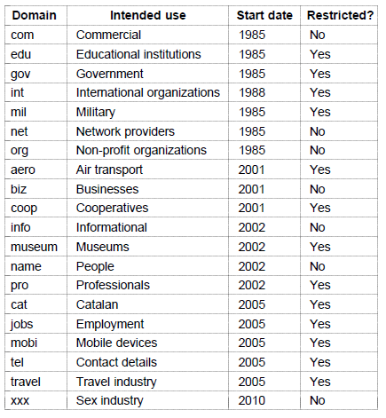
The DNS Name Space (2)
Generic top-level domains are controlled by ICANN who appoints registrars to run them
This one was controversial

Slide 11
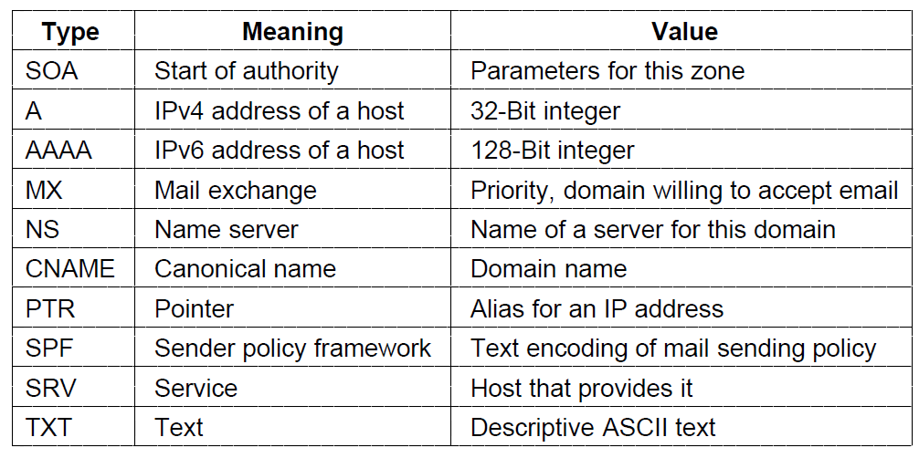
Domain Resource Records (1)
The key resource records in the namespace are IP addresses (A/AAAA) and name servers (NS), but there are others, too (e.g., MX)
(alias)
(reverse lookup)
(who can send)
(example: webserver)

Slide 12
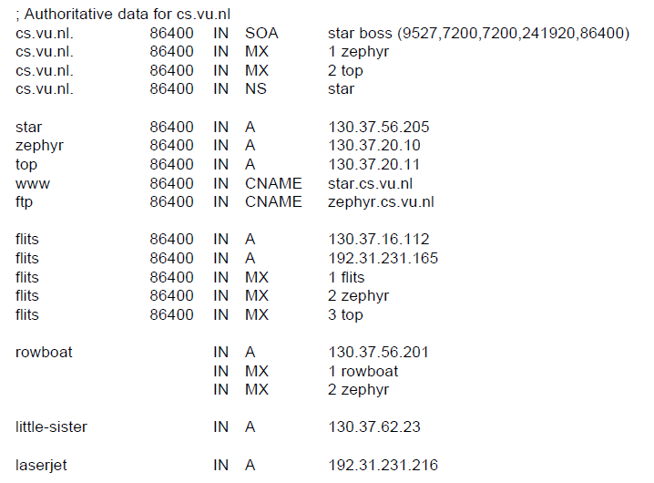
Domain Resource Records (2)
Name server
IP addresses of computers
Mail gateways
A portion of a possible DNS database for cs.vu.nl.

Slide 13
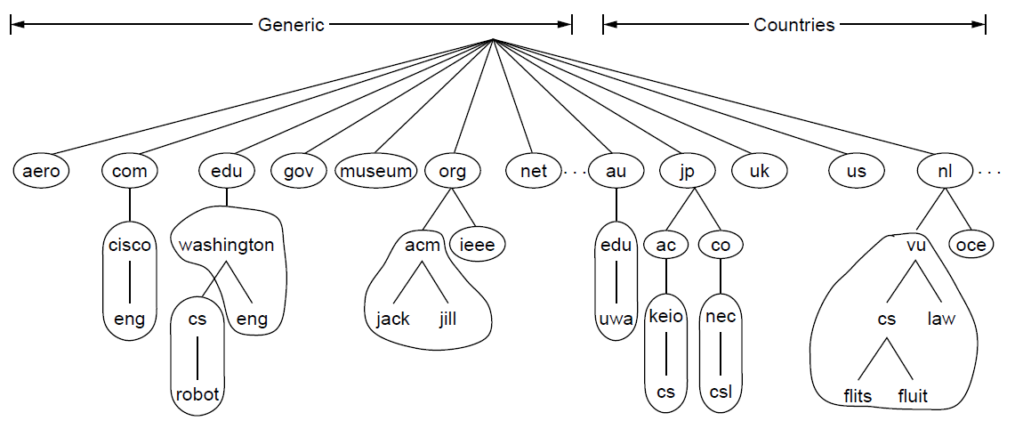
Name Servers (1)
Name servers contain data for portions of the name space called zones (circled).
Delegation
One zone a contiguous portion of the namespace

Slide 14
DNS – The Domain Name System
Each zone has a primary name server and one or more secondary servers
Records are either authoritative or cached
13 root servers, each heavily replicated
replicates geographically dispersed (130 locations)
Ten in U.S; also Amsterdam, Tokyo and Stockholm
reached by anycast to a-root-servers.net, then b-root-servers.net (if a doesn’t respond) and so on
local servers (millions of them) have NS records of root servers in a configuration file (named.ca)

Slide 15
Name Servers (2)
Finding the IP address for a given hostname is called resolution and is done with the DNS protocol.
Resolution:
Computer requests local name server to resolve
Local name server asks the root name server
Root returns the name server for a lower zone
Continue down zones until name server can answer
DNS protocol:
Runs on UDP port 53, retransmits lost messages
Caches name server answers for better performance

Slide 16
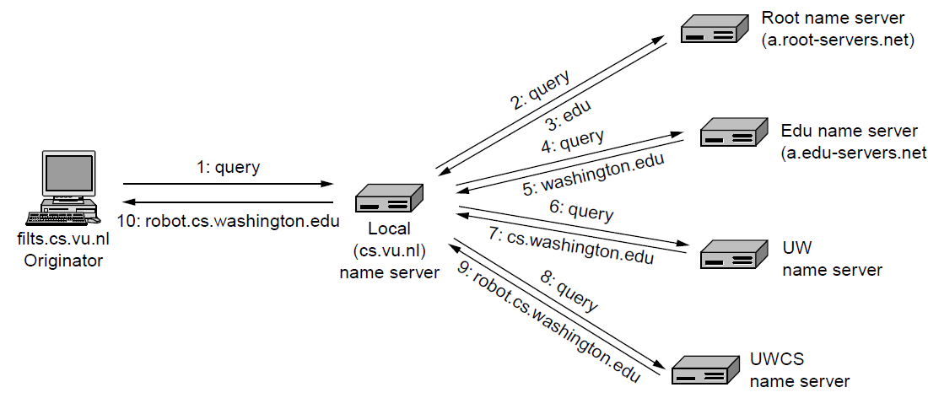
Name Servers (3)
referral
iterative queries – NS returns answer or who to contact
recursive query – this NS returns answer
resolver
Worst case example of a computer looking up the IP for a name
The workload is placed on the local name server; root servers provide simple responses

Slide 17

Attack on Twitter Through DNS
Pharming is an attack aiming to redirect a website’s traffic to a bogus website
AKA cache poisoning
Solution: DNSSEC
(DNS Security Extensions)
http://www.nytimes.com/2009/12/19/technology/internet/19twitter.html
SJW

Slide 18
Electronic Mail
Architecture and services »
The user agent »
Message formats »
Message transfer »
Final delivery »

Slide 19
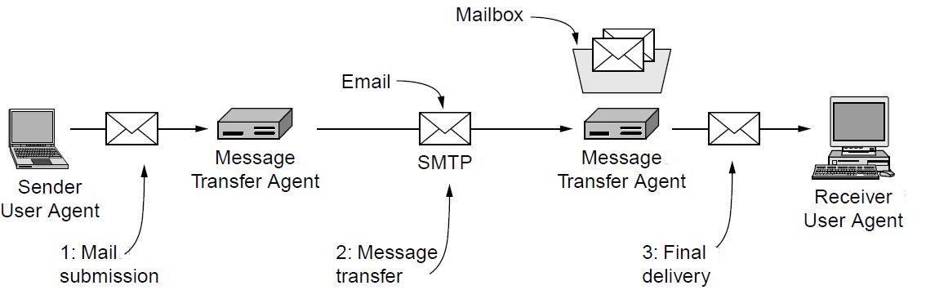
Architecture and Services (1)
The key components and steps (numbered) to send email
(RFC 822/5322 format)
(mail server)
(GUI)
MTA is both a client and a server
Architecture of the email system
MTA implements mail lists, cc, priority, encryption, delegation
(mail list can also be in UA)

Slide 20
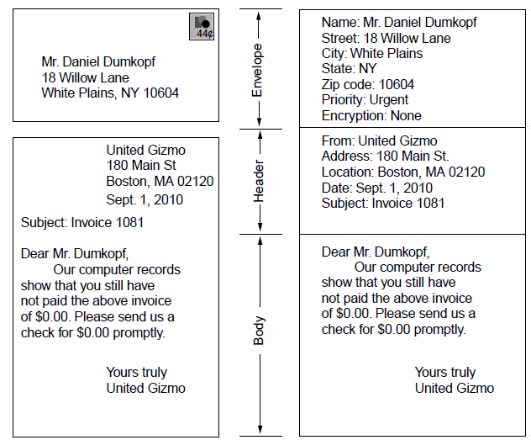
Architecture and Services (2)
Envelope
(used by MTA for routing)
(control info for UA)
Message (= header and body)
(for user)
Paper mail
Electronic mail

Slide 21
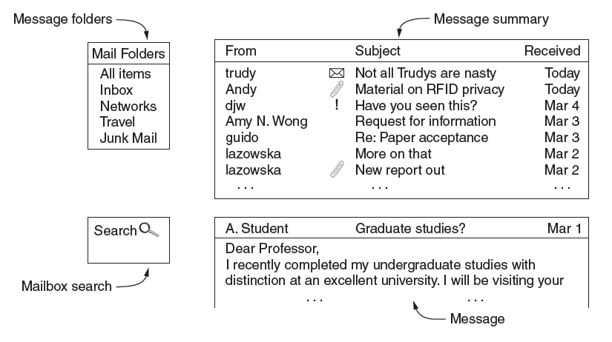
The User Agent
What users see – interface elements of a typical user agent
Examples of UAs: MS Outlook Opera Eudora Google gmail Mozilla Thunderbird

Slide 22
Spam
A canned meat product made by Hormel
Shoulder Pork and hAM"/"SPiced hAM“ luncheon meat
Spongy Pink Animal Matter
Something that keeps repeating and repeating to great annoyance http://www.youtube.com/watch?v=anwy2MPT5RE
SJW

Slide 23
Spam
Spam – unsolicited e-mail from businesses advertising goods and services
Generated by botnets
Gets past spam filters by
Inserting extra characters (V*I*A*G*A*R*A)
Inserting HTML tags that do nothing
<i> </i> is HTML for italicize (V<i></i>IAGARA)
Use of graphics (GIF, MPEG)
Replying usually increases, rather than decreases, amount of spam
Why?
SJW

Slide 24
Spam
Unsolicited email sent in bulk
Spamhaus estimates 90% of email is spam
http://www.spamhaus.org
Symantec MessageLabs (2013) estimates 69%
Down from 89% in 2010
http://www.messagelabs.com/intelligence.aspx
SJW

Slide 25
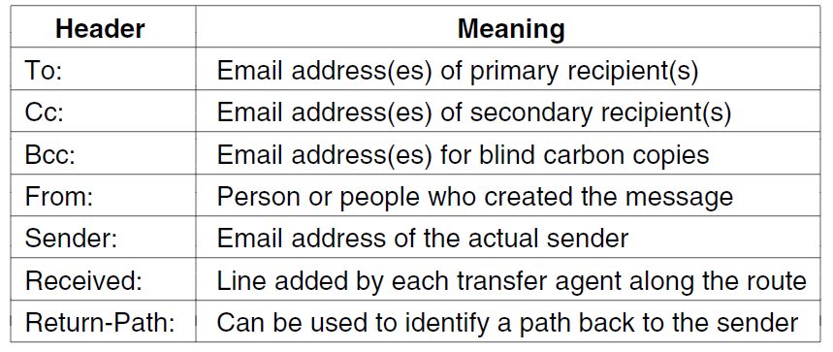
Message Formats (1)
Header fields related to message transport; headers are readable ASCII text

Slide 26
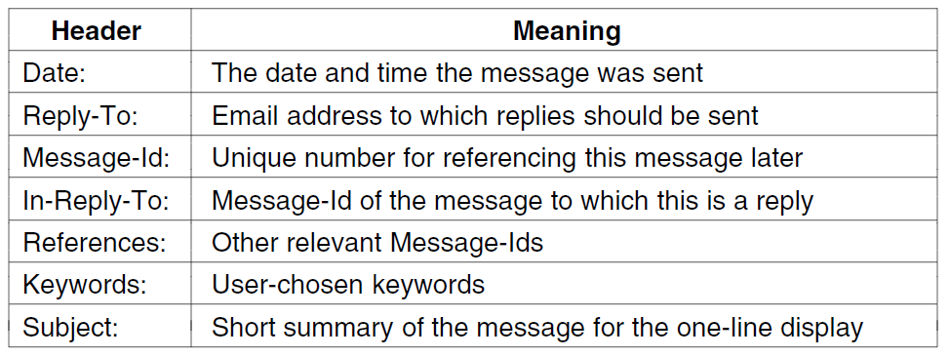
Message Formats (2)
Other header fields useful for user agents

Slide 27
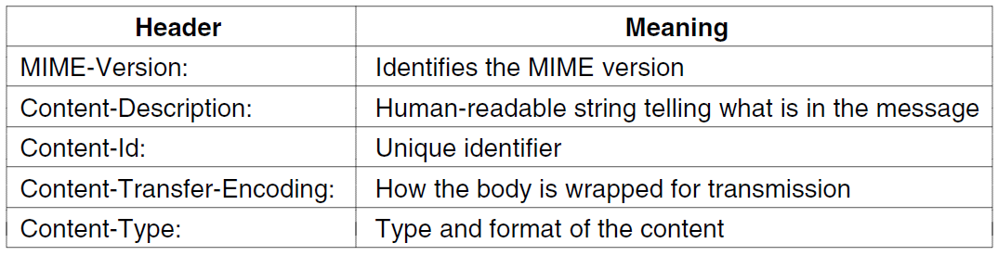
Message Formats (3)
MIME (Multipurpose Internet Mail Extensions) header fields used to describe what content is in the body of the message

Slide 28
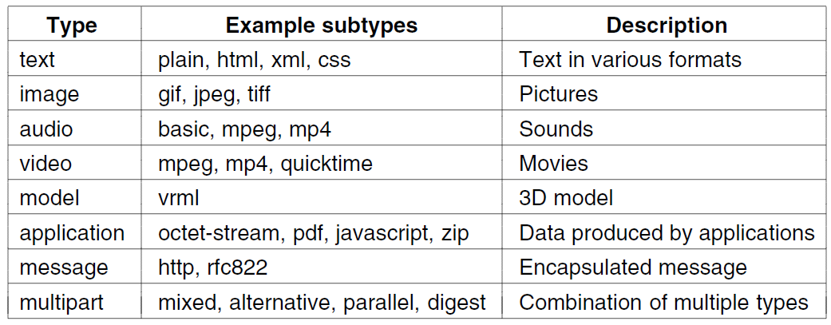
Message Formats (4)
Common MIME content types and subtypes

Slide 29
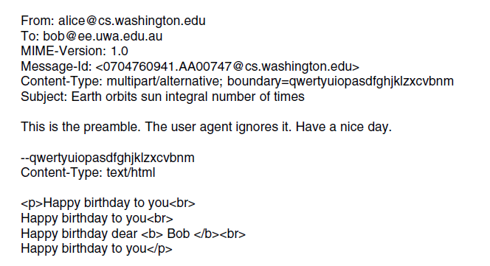
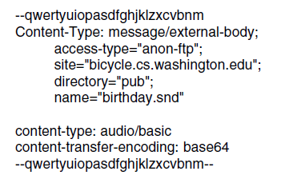
Message Formats (5)
Putting it all together: a multipart message containing HTML and audio alternatives.
One part (HTML)
Another
(audio)

Slide 30
Message Transfer (1)
Messages are transferred with SMTP (Simple Mail Transfer Protocol)
Readable text commands
Submission from user agent to MTA on port 587
One MTA to the next MTA on port 25
Other protocols for final delivery (IMAP, POP3)

Slide 31
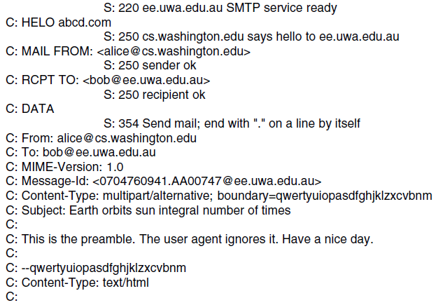
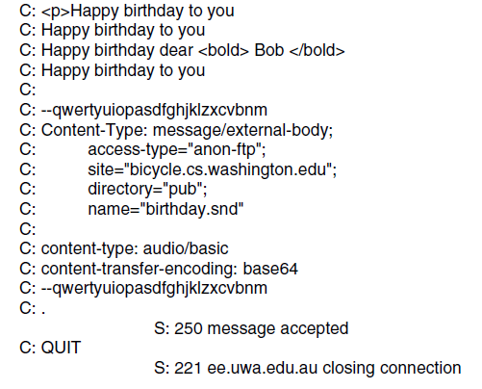
Message Transfer (2)
Sending a message:
From Alice to Bob
SMTP commands are marked [pink]
. . . (rest of message) . . .

Slide 32
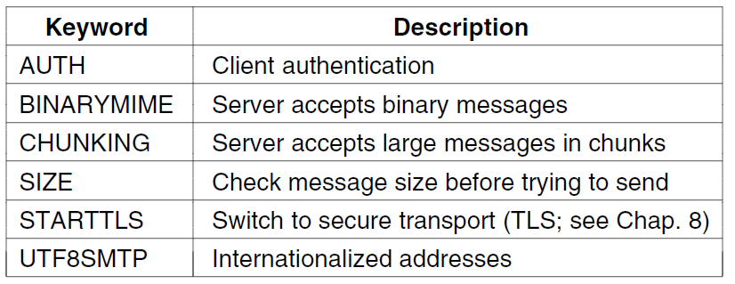
Message Transfer (3)
Common SMTP extensions (not in simple example)

Slide 33
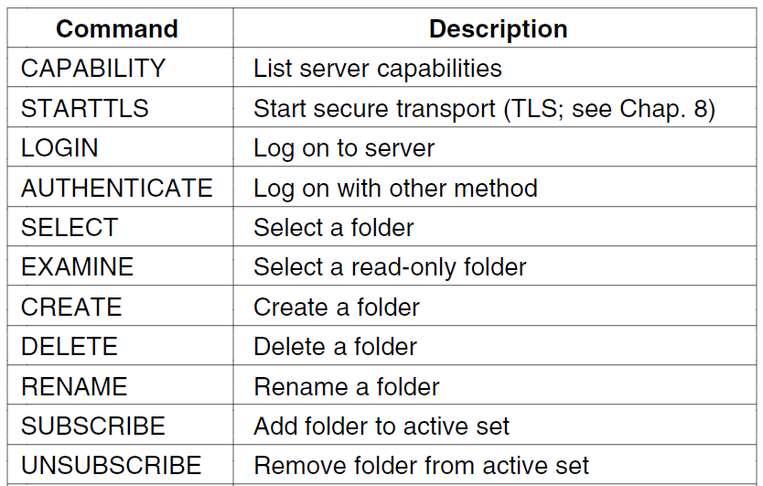
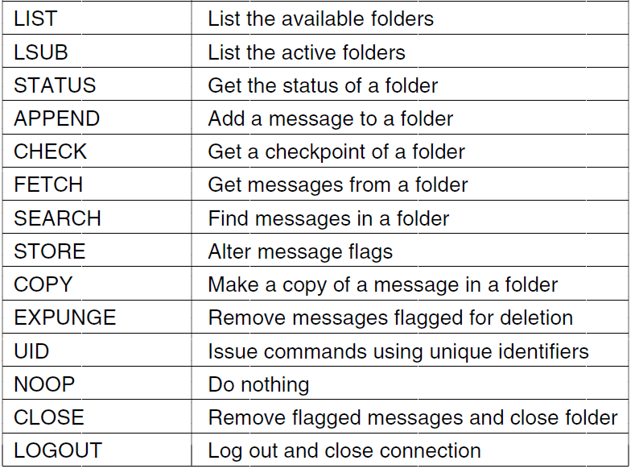
Final Delivery (1)
User agent uses protocol like IMAP for final delivery
Has commands to manipulate folders / messages [right]
Alternatively, a Web interface (with proprietary protocol) might be used

Slide 34
Webmail
Alternative to IMAP
UA provided as a service on Web
Web pages are processed by a web server, which retrieves/sends mail from/to MTA (mail server)
SJW

Slide 35
The World Wide Web
Architectural overview »
Static Web pages »
Dynamic pages and Web applications »
HTTP – HyperText Transfer Protocol »
The mobile Web »
Web search »

Slide 36
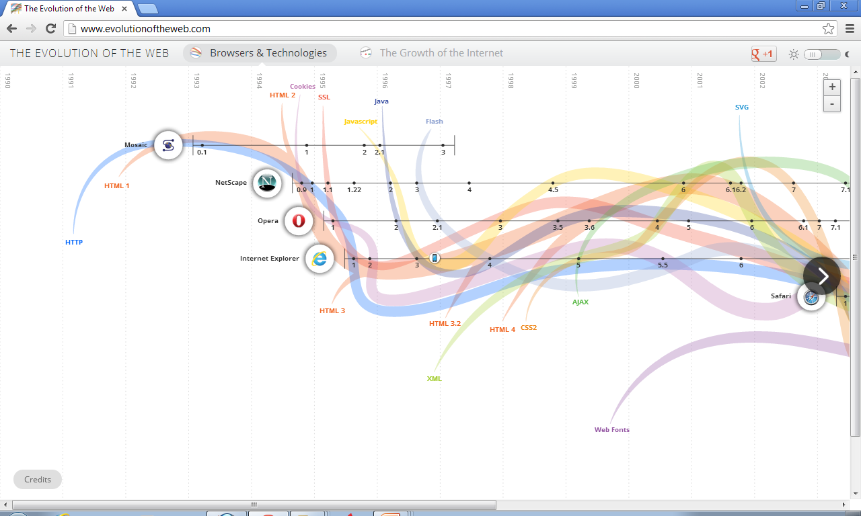
Evolution of the Web
Source: http://www.evolutionoftheweb.com, Vizzuality, Google, and Hyperakt
Notes:
Sergio Alvarez Leiva <saleiva@vizzuality.com>
11:50 AM (17 minutes ago)
to me, Javier
Hi David,
Glad you like it!
Yeah no problem, although the credit goes also to Google and Hyperakt :)
Cheers,
S.
On Feb 25, 2013, at 11:26 AM, David Wetherall wrote:
Hello, I'd like your permission to use the "Evolution of the Web" image from your site, with attribution credit to you, as part of the slides and videos I am preparing for my MOOC networking course, "Introduction to Computer Networks", which is now offered via Coursera. This course is used to teach computer networking to students online and in universities.
Is that OK?
Thanks,
David

Slide 37
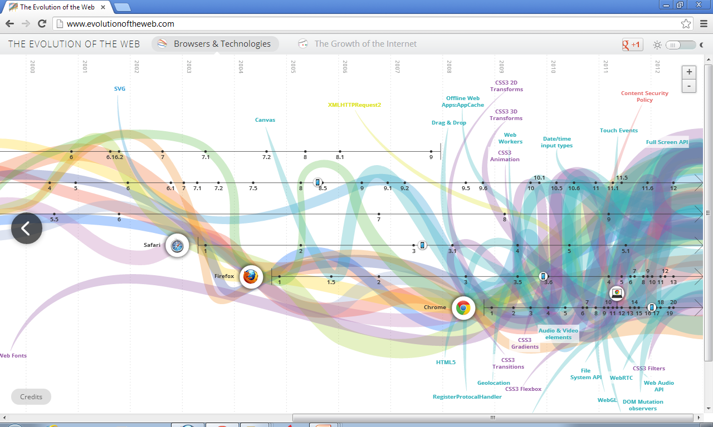
Evolution of the Web (2)
Source: http://www.evolutionoftheweb.com, Vizzuality, Google, and Hyperakt
Notes:
Sergio Alvarez Leiva <saleiva@vizzuality.com>
11:50 AM (17 minutes ago)
to me, Javier
Hi David,
Glad you like it!
Yeah no problem, although the credit goes also to Google and Hyperakt :)
Cheers,
S.
On Feb 25, 2013, at 11:26 AM, David Wetherall wrote:
Hello, I'd like your permission to use the "Evolution of the Web" image from your site, with attribution credit to you, as part of the slides and videos I am preparing for my MOOC networking course, "Introduction to Computer Networks", which is now offered via Coursera. This course is used to teach computer networking to students online and in universities.
Is that OK?
Thanks,
David

Slide 38
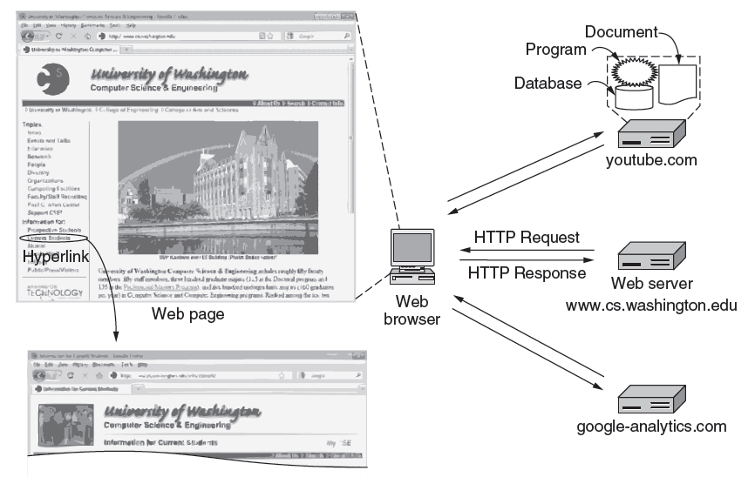
Architectural Overview (1)
HTTP transfers pages from servers to browsers
(visitor tracking and cookie)

Slide 39
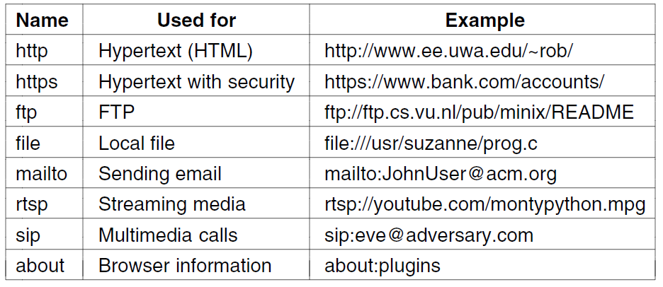
Architectural Overview (2)
Pages are named with URLs (Uniform Resource Locators)
Example: http://www.phdcomics.com/comics.php
Protocol
Server
Page on server
Our
focus
Common URL protocols

Slide 40
Architectural Overview (3)
Steps a client (browser) takes to follow a hyperlink:
Determine the protocol (HTTP)
Ask DNS for the IP address of server
Make a TCP connection to server
Send request for the page; server sends it back
Execute/fetch embedded resources as needed to display (render) the page
Close idle TCP connections
Steps a server takes to serve pages:
Accept a TCP connection from client
Get page request and map it to a resource (e.g., file name)
Get the resource (e.g., file from disk)
Send contents of the resource to the client.
Release idle TCP connections

Slide 41
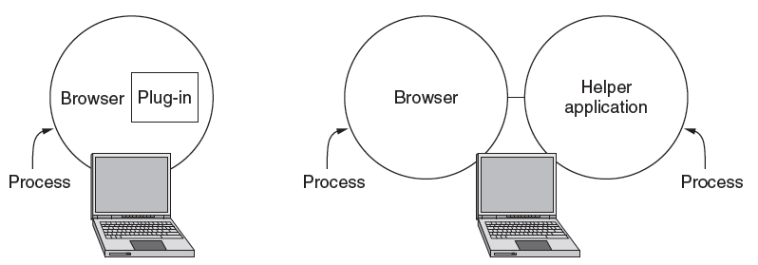
Architectural Overview (4)
Content type is identified by MIME types
Browser takes the appropriate action to display
Plug-ins / helper apps extend browser for new types
Examples: Adobe Reader, Flash, Quicktime
Examples: Adobe Photoshop, Word

Slide 42
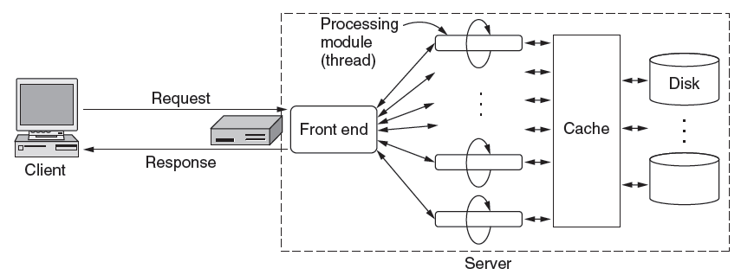
Architectural Overview (5)
To scale performance, Web servers can use:
Caching, multiple threads, and a front end

Slide 43
Architectural Overview (6)
Server steps, revisited:
Resolve name of Web page requested
Perform access control on the Web page
Check the cache
Fetch requested page from disk or run program
Determine the rest of the response
Return the response to the client
Make an entry in the server log

Slide 44
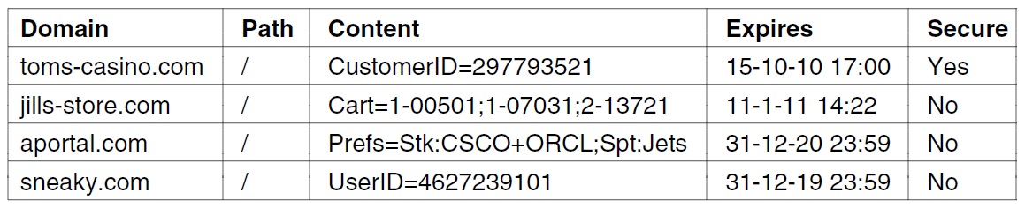
Architectural Overview (7)
Cookies support stateful client/server interactions
Server sends cookies (state) with page response
Client stores cookies across page fetches
Client sends cookies back to server with requests
*
**
Examples of cookies
* browser must use SSL/TLS to return cookie
** used to track visits by sending a third-party cookie with the link to an advertisement – later, when the user is served another ad (which could be a single pixel) from the same ad placement service, the UserID in the cookie is used to track the site visit history of the user

Slide 45
Static Web Pages (1)
Static Web pages are simply files
Have the same contents for each viewing
Can be visually rich and interactive nonetheless:
HTML that mixes text and images
Forms that gather user input
Style sheets that tailor presentation
Vector graphics, videos, and more (over) . . .
HTML example: tags <b> XXX </b> indicates the string XXX is to be rendered in boldface

Slide 46
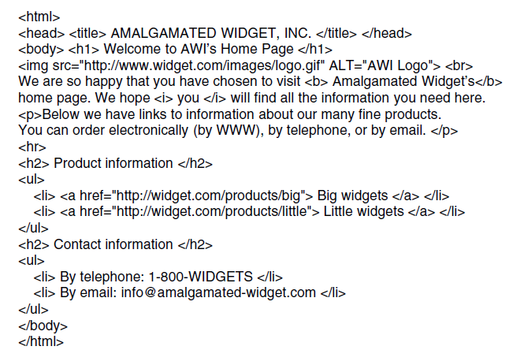
Static Web Pages (2)
tag
attribute
directive
anchor and
hyperlink
The HTML for a sample Web page (see next slide).

Slide 47
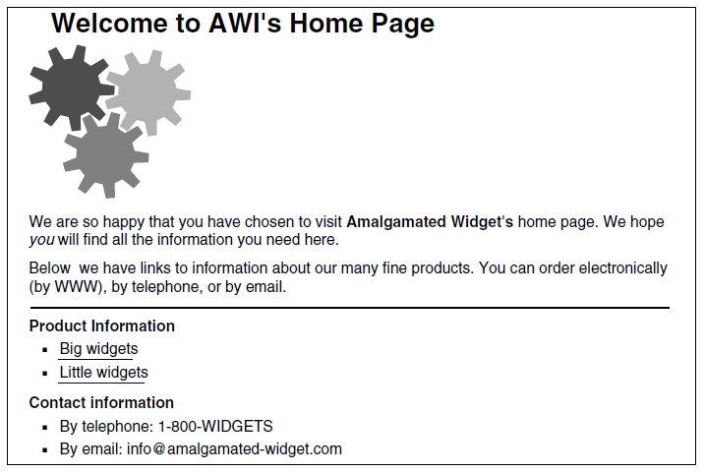
Static Web Pages (3)
The formatted page (see previous slide).

Slide 48
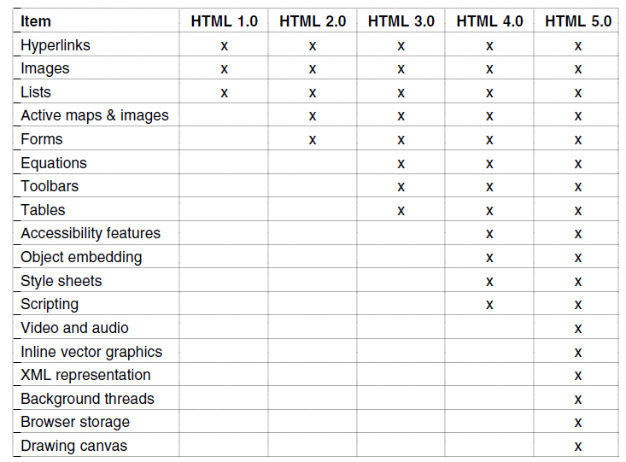
Static Web Pages (5)
Progression of features through HTML 5.0

Slide 49
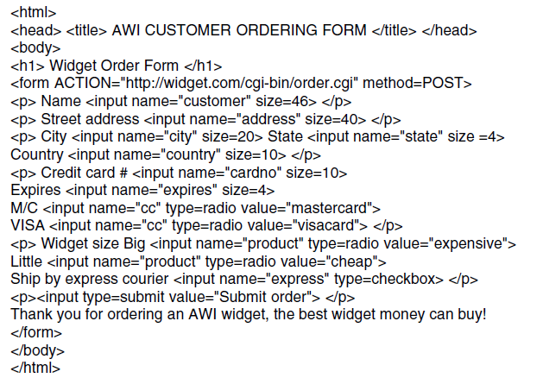
Static Web Pages (4)
The HTML for an order form.

Slide 50
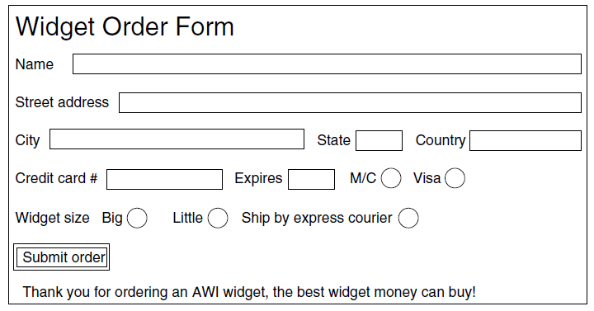
Static Web Pages (4)
Radio button
checkbox
The formatted page.

Slide 51
Forms
Additional capabilities:
Drop-down lists
Password fields
Multi-line text
Default values

Slide 52
Cascading Style Sheets (CSS)
Logical, rather than physical formatting
rather than applying a bold format to a string, apply a set of formatting attributes to a portion of the document such as the first paragraph or all paragraphs
enables consistent style across documents
enables a change to be applied to all documents that use that style sheet
permits HTML developers to concentrate on content, not appearance

Slide 53
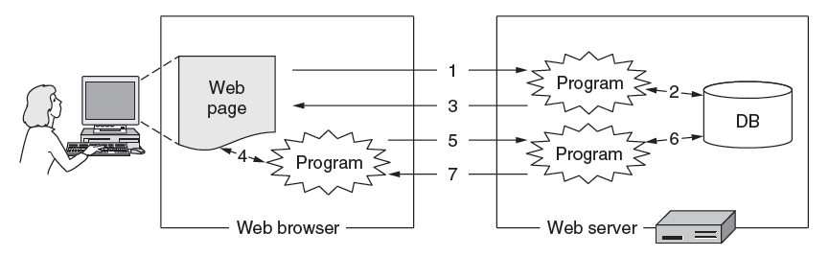
Dynamic Pages & Web Applications (1)
Dynamic pages are generated by programs running at the server (with a database) and the client
E.g., PHP at server*, JavaScript at client
Pages vary each time like using an application
* Or use CGI at server to invoke a program which returns HTML, including the data to be displayed
This is similar to what happens when you use Google maps

Slide 54
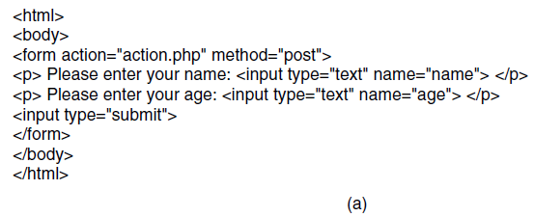
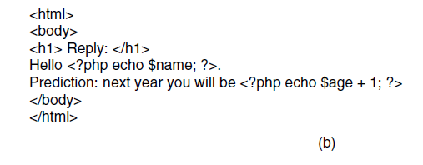
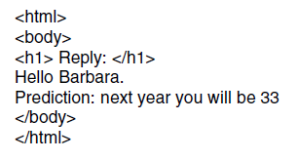
Dynamic Pages & Web Applications (2)
name of script to be executed on server
Web page that gets form input and calls a server program
PHP calls
PHP server program that creates a custom Web page
Resulting Web page (for inputs “Barbara” and “32”)

Slide 55
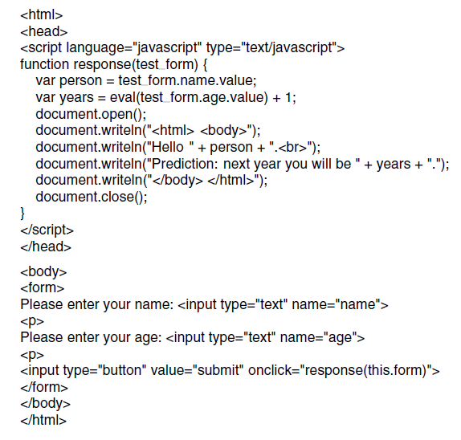
Dynamic Pages & Web Applications (3)
Dynamic HTML
JavaScript program (unrelated to Java), VBScript, Java applets or MS ActiveX controls produces result page in the browser
First page with form, gets input and calls program above

Slide 56
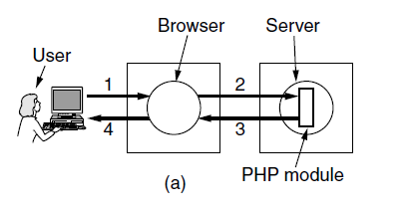
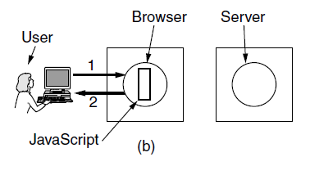
Dynamic Pages & Web Applications (4)
The difference between server and client programs
Server-side scripting with PHP
Client-side scripting with JavaScript

Slide 57
Dynamic Pages & Web Applications (5)
Web applications use a set of technologies that work together, e.g. AJAX (Asynchronous JAvaScript and Xml):
HTML and CSS: present information as pages.
DOM (Document Object Model): change parts of pages while they are viewed.
XML: let programs exchange data with the server.
Example of an XML dialect: XBRL
Asynchronous way to send and retrieve XML data without blocking screen.
JavaScript as a language to bind all this together.
Google Gmail, Maps, Docs written using AJAX

Slide 58
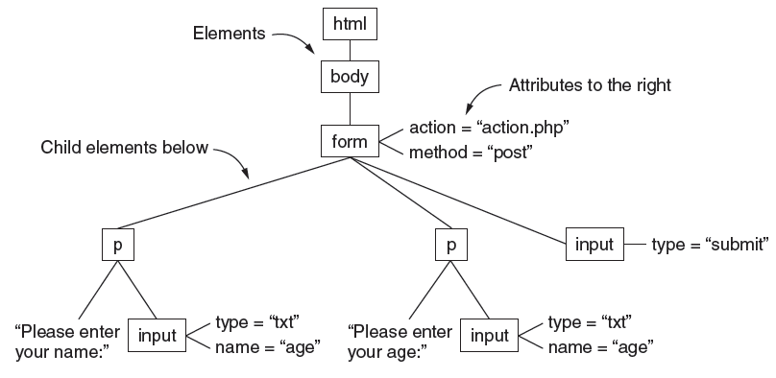
Dynamic Pages & Web Applications (6)
The DOM (Document Object Model) tree represents Web pages as a structure that programs can alter
A program can change part of a page by replacing a node rather than the whole page

Slide 59
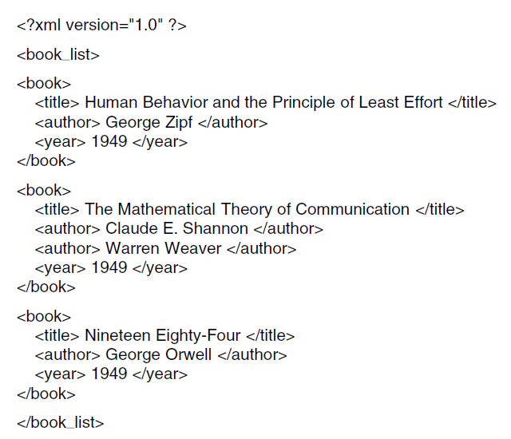
Dynamic Pages & Web Applications (7)
XML captures document structure, not presentation like HTML. Ex:

Slide 60
Web Service Invoked by RPC
Web Service: When HTTP is used to transport RPC requests and responses (formatted as XML) between a client and server
SOAP: Simple Object Access Protocol specifies protocols to use

Slide 61
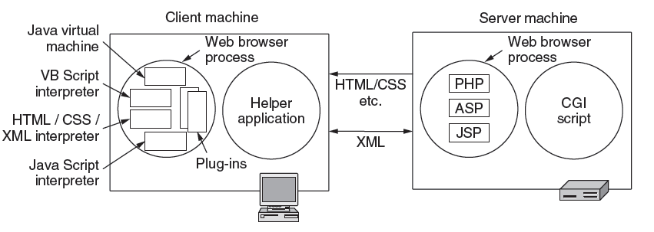
Dynamic Pages & Web Applications (8)
Web applications use a set of technologies, revisited:
ActiveX
AJAX supports rich Web applications that look like traditional applications

Slide 62
Evolution of HTTP
Consider security (SSL/TLS for HTTPS) later
Proliferation of content types and browser/server scripting technologies
SPDY
(HTTP 2.0)
1.1 developed
(persistent connections)
1.0 developed
RFC 2616
RFC 2965
0.9
RFC 2068, 2109
Cookies
SSL 2.0
RFC 1945
1990
1995
2000
2005
2010

Slide 63
HTTP (1)
HTTP (HyperText Transfer Protocol) is a request-response protocol that runs on top of TCP
Fetches pages from server to client
Server usually runs on port 80
Headers are given in readable ASCII
Content is described with MIME types
Protocol has support for pipelining requests
Protocol has support for caching

Slide 64
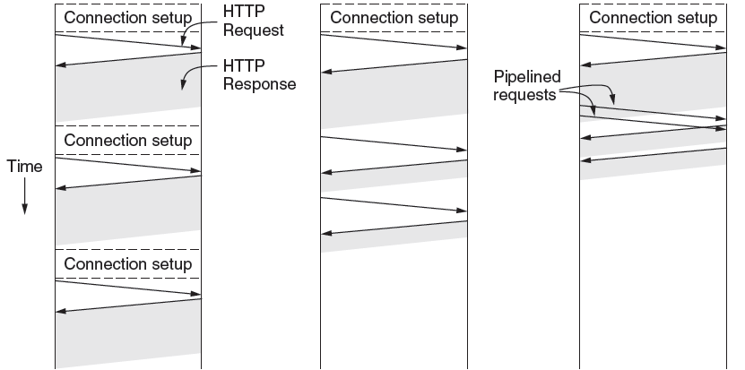
HTTP (2)
HTTP uses persistent connections to improve performance
One connection for each request
Sequential requests on one connection
Pipelined requests on one connection

Slide 65
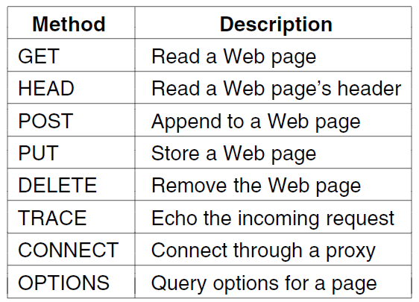
HTTP (3)
HTTP has several request methods.
Fetch a page
Used to send input data to a server program

Slide 66
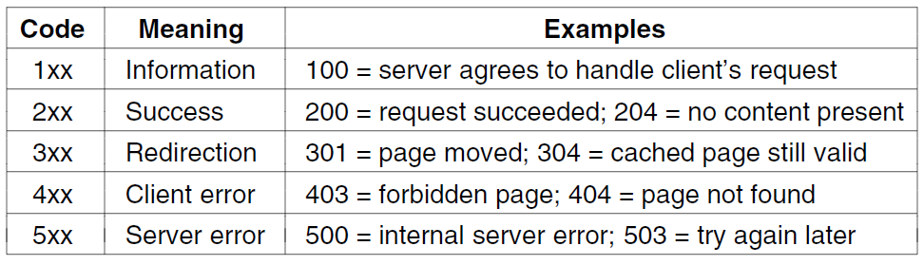
HTTP (4)
Response codes tell the client how the request fared:

Slide 67
HTTP (5)
Many headers carry key information:
Function | Example Headers
Browser capabilities (client → server) | User-Agent, Accept, Accept-Charset, Accept-Encoding, Accept-Language
Caching related (mixed directions) | If-Modified-Since, If-None-Match, Date, Last-Modified, Expires, Cache-Control, ETag
Browser context (client → server) | Cookie, Referer, Authorization, Host
Content delivery (server → client) | Content-Encoding, Content-Length, Content-Type, Content-Language, Content-Range, Set-Cookie

Slide 68
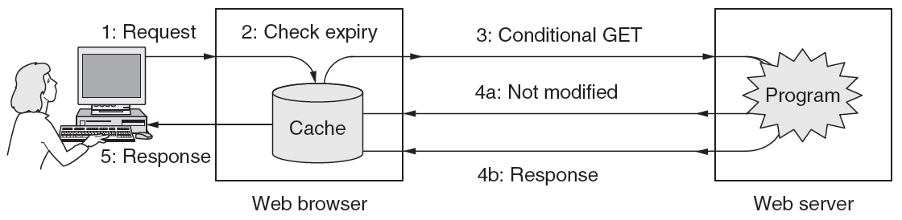
HTTP (6)
HTTP caching checks to see if the browser has a known fresh copy, and if not if the server has updated the page
Uses a collection of headers for the checks
Can include further levels of caching (e.g., proxy)

Slide 69
The Mobile Web
Mobiles (phones, tablets) are challenging as clients:
Relatively small screens
Limited input capabilities, lengthy input.
Network bandwidth is limited
Connectivity may be intermittent.
Computing power is limited
Strategies to handle them:
Content: intermediate servers provide mobile-friendly versions; transcoding can also be used
Protocols: no need for specialized protocols (WAP*); HTTP with TCP/IP header compression sufficient
* Wireless Application Protocol used by feature phones

Slide 70
Web Search
Search has proved hugely popular, in tandem with advertising that has proved hugely profitable
A simple interface for users to navigate the Web
Search engine requires:
Content from all sites, accessed by crawling. Follow links to new pages, but beware programs.
Deep web: Hidden (dynamic content) a problem
Indexing, which benefits from known and discovered structure (such as XML) to increase relevance

Slide 71
Streaming Audio and Video
Audio and video have become key types of traffic, e.g., voice over IP, and video streaming.
Digital audio »
Digital video »
Streaming stored media »
Streaming live media »
Real-time conferencing »

Slide 72
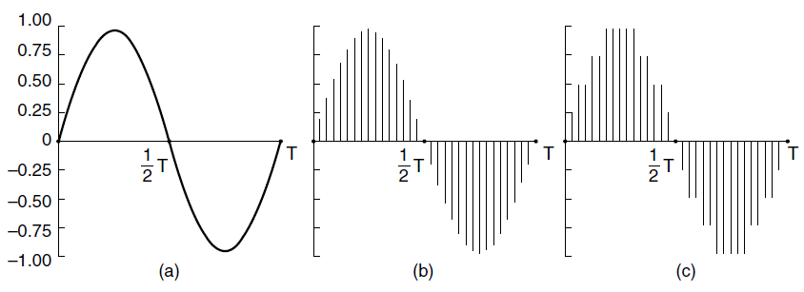
Digital Audio (1)
ADC (Analog-to-Digital Converter) produces digital audio from a microphone
Telephone: 8000 8-bit samples/second (64 Kbps); computer audio is usually better quality (e.g., 16 bit)
ADC
Continuous audio
(sine wave)
Digital audio
(sampled, 4-bit quantized)

Slide 73
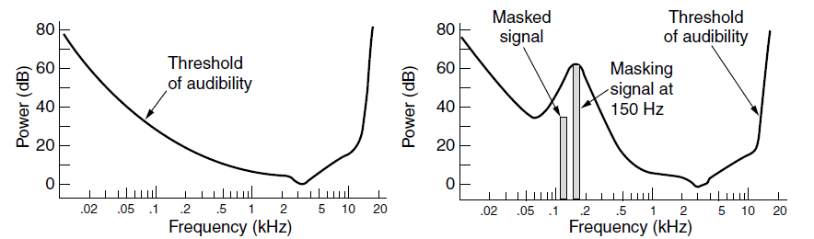
Digital Audio (2)
Digital audio is typically compressed before it is sent
Lossy encoders (like AAC) exploit human perception
Large compression ratios (can be >10X)
Sensitivity of the ear varies with frequency
A loud tone can mask nearby tones

Slide 74
Digital Video (1)
Video is digitized as pixels (sampled, quantized)
TV quality: 640x480 pixels, 24-bit color, 30 times/sec
Video is sent compressed due to its large bandwidth
Lossy compression exploits human perception
E.g., JPEG for still images, MPEG, H.264 for video
Large compression ratios (often 50X for video)
Video is normally > 1 Mbps, versus >10 kbps for speech and >100 kbps for music

Slide 75
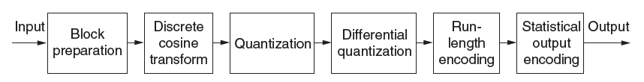
Digital Video (2)
JPEG lossy compression sequence for one image:
Step 1
Step 2
Step 3
Step 5

Slide 76
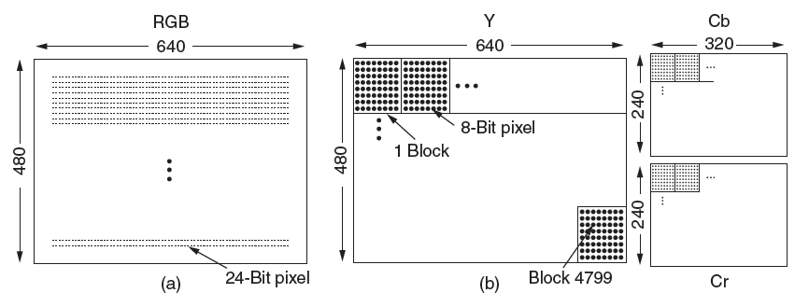
Digital Video (3)
Step 1: Pixels are mapped to luminance/chrominance (YCbCr) color space and chrominance is sub-sampled
The eye is less sensitive to chrominance
Input 24-bit RGB pixels
8-bit luminance pixels
8-bit chrominances for every 4 pixels

Slide 77

Digital Video (4)
Step 2: Each component block is transformed to spatial frequencies with DCT (Discrete Cosine Transformation)
Captures the key image features
One component block
Transformed block

Slide 78

Digital Video (5)
Step 3: DCT coefficients are quantized by dividing by thresholds; reduces bits in higher spatial frequencies
Top left element is differenced over blocks (Step 4)
Input
/
Thresholds
=
Output

Slide 79

Digital Video (6)
Step 5: The block is run-length encoded in a zig-zag order. Then it is Huffman coded before sending (Step 6)
Order in which the block coefficients are sent

Slide 80

Digital Video (7)
MPEG compresses over a sequence of frames, further using motion tracking to remove temporal redundancy
I (Intra-coded) frames are self-contained
P (Predictive) frames use block motion predictions
B (Bidirectional) frames may base prediction on future frame
Three consecutive frames with stationary and moving components

Slide 81

Streaming Stored Media (1)
A simple method to stream stored media, e.g., for video on demand, is to fetch the video as a file download
But has large startup delay, except for short files

Slide 82

Streaming Stored Media (2)
Effective streaming starts the playout during transport
With RTSP (Real-Time Streaming Protocol)

Slide 83
Streaming Stored Media (3)
Key problem: how to handle transmission errors
Strategy | Advantage | Disadvantage
Use reliable transport (TCP) | Repairs all errors | Increases jitter significantly
Add FEC (e.g., parity) | Repairs most errors | Increases overhead, decoding complexity and jitter
Interleave media | Masks most errors | Slightly increases decoding complexity and jitter

Slide 84

Streaming Stored Media (4)
Parity packet can repair one lost packet in a group of N
Decoding is delayed for N packets

Slide 85

Streaming Stored Media (5)
Interleaving spreads nearby media samples over different transmissions to reduce the impact of loss
Packet stream
Media samples
Loss reduces temporal resolution; doesn’t leave a gap

Slide 86

Streaming Stored Media (6)
Key problem: media may not arrive in time for playout due to variable bandwidth and loss/retransmissions
Client buffers media to absorb jitter; we still need to pick an achievable media rate
Safety margin, to avoid a stall
Can pause server (or go ahead and save to disk)

Slide 87

Streaming Stored Media (7)
RTSP commands
Sent from player to server to adjust streaming

Slide 88
Streaming Live Media (1)
Streaming live media is similar to the stored case plus:
Can’t stream faster than “live rate” to get ahead
Usually need larger buffer to absorb jitter
Often have many users viewing at the same time
UDP with multicast greatly improves efficiency. It is rarely available, so many TCP connections are used.
For very many users, content distribution is used [later]
Notes:
An example of streaming live media is watching the French Open tennis tournament.
IP multicast is usually not available across the Internet. It is most likely to be available in a single providers network, such as a closed IPTV cable network.

Slide 89

Streaming Live Media (2)
With multicast streaming media, parity is effective
Clients can each lose a different packet and recover

Slide 90
Streaming Stored Media (5)
Interleaving spreads nearby media samples over different transmissions to reduce the impact of loss
Packet stream
Media samples
Loss reduces temporal resolution; doesn’t leave a gap

Slide 91
Streaming Stored Media (6)
Key problem: media may not arrive in time for playout due to variable bandwidth and loss/retransmissions
Client buffers media to absorb jitter; we still need to pick an achievable media rate
Safety margin, to avoid a stall
Can pause server (or go ahead and save to disk)

Slide 92
Streaming Stored Media (7)
RTSP commands
Sent from player to server to adjust streaming

Slide 93
Streaming Live Media (1)
Streaming live media is similar to the stored case plus:
Can’t stream faster than “live rate” to get ahead
Usually need larger buffer to absorb jitter
Often have many users viewing at the same time
UDP with multicast greatly improves efficiency. It is rarely available, so many TCP connections are used.
For very many users, content distribution is used [later]
Notes:
An example of streaming live media is watching the French Open tennis tournament.
IP multicast is usually not available across the Internet. It is most likely to be available in a single providers network, such as a closed IPTV cable network.

Slide 94
Streaming Live Media (2)
With multicast streaming media, parity is effective
Clients can each lose a different packet and recover

Slide 95

Streaming Live Media (2)
Production side of a student radio station.
As before

Slide 96
Streaming Audio and Video
Audio and video have become key types of traffic, e.g., voice over IP, and video streaming.
Digital audio »
Digital video »
Streaming stored media »
Streaming live media »
Real-time conferencing »

Slide 97
Digital Audio (1)
ADC (Analog-to-Digital Converter) produces digital audio from a microphone
Telephone: 8000 8-bit samples/second (64 Kbps); computer audio is usually better quality (e.g., 16 bit)
ADC
Continuous audio
(sine wave)
Digital audio
(sampled, 4-bit quantized)

Slide 98
Digital Audio (2)
Digital audio is typically compressed before it is sent
Lossy encoders (like AAC) exploit human perception
Large compression ratios (can be >10X)
Sensitivity of the ear varies with frequency
A loud tone can mask nearby tones

Slide 99
Digital Video (1)
Video is digitized as pixels (sampled, quantized)
TV quality: 640x480 pixels, 24-bit color, 30 times/sec
Video is sent compressed due to its large bandwidth
Lossy compression exploits human perception
E.g., JPEG for still images, MPEG, H.264 for video
Large compression ratios (often 50X for video)
Video is normally > 1 Mbps, versus >10 kbps for speech and >100 kbps for music

Slide 100
Digital Video (2)
JPEG lossy compression sequence for one image:
Step 1
Step 2
Step 3
Step 5

Slide 101
Digital Video (3)
Step 1: Pixels are mapped to luminance/chrominance (YCbCr) color space and chrominance is sub-sampled
The eye is less sensitive to chrominance
Input 24-bit RGB pixels
8-bit luminance pixels
8-bit chrominances for every 4 pixels

Slide 102
Digital Video (4)
Step 2: Each component block is transformed to spatial frequencies with DCT (Discrete Cosine Transformation)
Captures the key image features
One component block
Transformed block

Slide 103
Digital Video (5)
Step 3: DCT coefficients are quantized by dividing by thresholds; reduces bits in higher spatial frequencies
Top left element is differenced over blocks (Step 4)
Input
/
Thresholds
=
Output

Slide 104
Digital Video (6)
Step 5: The block is run-length encoded in a zig-zag order. Then it is Huffman coded before sending (Step 6)
Order in which the block coefficients are sent

Slide 105
Digital Video (7)
MPEG compresses over a sequence of frames, further using motion tracking to remove temporal redundancy
I (Intra-coded) frames are self-contained
P (Predictive) frames use block motion predictions
B (Bidirectional) frames may base prediction on future frame
Three consecutive frames with stationary and moving components

Slide 106
Streaming Stored Media (1)
A simple method to stream stored media, e.g., for video on demand, is to fetch the video as a file download
But has large startup delay, except for short files

Slide 107
Streaming Stored Media (2)
Effective streaming starts the playout during transport
With RTSP (Real-Time Streaming Protocol)

Slide 108
Streaming Stored Media (3)
Key problem: how to handle transmission errors
Strategy | Advantage | Disadvantage
Use reliable transport (TCP) | Repairs all errors | Increases jitter significantly
Add FEC (e.g., parity) | Repairs most errors | Increases overhead, decoding complexity and jitter
Interleave media | Masks most errors | Slightly increases decoding complexity and jitter

Slide 109
Streaming Stored Media (4)
Parity packet can repair one lost packet in a group of N
Decoding is delayed for N packets

Slide 110
Streaming Stored Media (5)
Interleaving spreads nearby media samples over different transmissions to reduce the impact of loss
Packet stream
Media samples
Loss reduces temporal resolution; doesn’t leave a gap

Slide 111
Streaming Stored Media (6)
Key problem: media may not arrive in time for playout due to variable bandwidth and loss/retransmissions
Client buffers media to absorb jitter; we still need to pick an achievable media rate
Safety margin, to avoid a stall
Can pause server (or go ahead and save to disk)

Slide 112
Streaming Stored Media (7)
RTSP commands
Sent from player to server to adjust streaming

Slide 113
Streaming Live Media (1)
Streaming live media is similar to the stored case plus:
Can’t stream faster than “live rate” to get ahead
Usually need larger buffer to absorb jitter
Often have many users viewing at the same time
UDP with multicast greatly improves efficiency. It is rarely available, so many TCP connections are used.
For very many users, content distribution is used [later]
Notes:
An example of streaming live media is watching the French Open tennis tournament.
IP multicast is usually not available across the Internet. It is most likely to be available in a single providers network, such as a closed IPTV cable network.

Slide 114
Streaming Live Media (2)
With multicast streaming media, parity is effective
Clients can each lose a different packet and recover

Slide 115
Streaming Live Media (2)
Production side of a student radio station.
As before

Slide 116
Real-Time Conferencing (1)
Real-time conferencing has two or more connected live media streams, e.g., voice over IP, Skype video call
Key issue over live streaming is low (interactive) latency
Want to reduce delay to near propagation
Benefits from network support, e.g., QoS
Or, benefits from ample bandwidth (no congestion)

Slide 117

Real-Time Conferencing (2)
H.323 architecture for Internet telephony supports calls between Internet computers and PSTN phones.
VoIP
call
Internet/PSTN
Internet
Gatekeeper controls calls for LAN hosts

Slide 118

Real-Time Conferencing (3)
H.323 protocol stack:
Call is digital audio/video over RTP/UDP/IP
Call setup is handled by other protocols (Q.931 etc.)

Slide 119

Real-Time Conferencing (4)
Logical channels that make up an H.323 call

Slide 120

Real-Time Conferencing (5)
SIP (Session Initiation Protocol) is an alternative to H.323 to set up real-time calls
Simple, text-based protocol with URLs for addresses
Data is carried with RTP / RTCP as before

Slide 121

Real-Time Conferencing (6)
Setting up a call with the SIP three-way handshake
Proxy server lets a remote callee be connected
Call data flows directly between caller/callee

Slide 122

Real-Time Conferencing (7)
Comparison of H.323 and SIP.

Slide 123
Content Delivery
Delivery of content, especially Web and video, to users is a major component of Internet traffic
Content and Internet traffic »
Server farms and Web proxies »
Content delivery networks »
Peer-to-peer networks »

Slide 124

Content and Internet Traffic
Internet traffic:
Shifts seismically (email→FTP→Web→P2P→video)
Has many small/unpopular and few large/popular flows – mice and elephants
Zipf popularity distribution, 1/k
Shows up as a line on log-log plot
The Long Tail, Anderson

Slide 125

Server Farms and Web Proxies (1)
Server farms enable large-scale Web servers:
Front-end load-balances requests over servers
Servers access the same backend database

Slide 126
Load Balancing
DNS: round-robin based on DNS records returned for the name query
Hardware load balancer
Based on last bits of source IP
Something in app header, e.g., cookie
TCP port number
Use a mainframe
Large number of processors
Machines can be clustered
Huge I/O rate
SJW

Slide 127

Server Farms and Web Proxies (2)
Proxy caches help organizations to scale the Web
Caches server content over clients for performance
Also implements organization policies (e.g., access)
Further levels of proxies may be added

Slide 128

CDNs – Content Delivery Networks (1)
CDNs scale Web servers by having clients get content from a nearby CDN node (cache)

Slide 129
Content Delivery Networks
How to direct clients to closest server?
Simple approach: mirroring. Each region has its own mirror. User manually selects a mirror, usually by clicking on a map
DNS redirection, used by CDNs (see following slides) such as Akamai
Anycast redirection (not covered in text, used by Cloudflare

Slide 130

Content Delivery Networks (2)
Directing clients to nearby CDN nodes with DNS:
Client query returns local CDN node as response
Local CDN node caches content for nearby clients and reduces load on the origin server

Slide 131

Content Delivery Networks (3)
Origin server rewrites pages to serve content via CDN
Traditional Web page on server
Page that distributes content via CDN

Slide 132
Content Delivery Networks
How to direct clients to closest server?
User enters nytimes.com in browser URL box.
Browser uses DNS to return nytimes IP address.
Browser contacts nytimes site and displays home page.
User is interested in a story and clicks link (which has been processed to replace nytimes domain name with CDN domain name)
Browser uses DNS to look up cdn.com
Note that steps 6 through 10 can be replaced as indicated on slides entitled “CDN - DNS redirection”

Slide 133
Content Delivery Networks
How to direct clients to closest server?
* DNS server returns CDN IP address
* Browser sends HTTP request for page to CDN server at well-known port for web servers, port 80.
* CDN server accepts connection (though it is not a web server!). Examines request, determines which customer’s data is being requested (NY Times), looks at browser’s source IP address, does table lookup to learn where that IP address is situated.
* Note that steps 6 through 10 can be replaced as indicated on slides entitled “CDN - DNS redirection”

Slide 134
Content Delivery Networks
How to direct clients to closest server?
* CDN returns status code 301, “permanently moved”, and redirects browser to a CDN server that is near the browser and which contains www.nytimes.com content.
* Browser redirects request to closest CDN server.
Cached file is returned to browser from closest CDN server.
* Note that steps 6 through 10 can be replaced as indicated on slides entitled “CDN - DNS redirection”

Slide 135
Content Delivery Networks
How to direct clients to closest server?
All further requests from this client for www.nytimes.com pages are satisfied by the local CDN server, since all of the www.nytimes.com pages stored there point to other www.nytimes.com pages stored at the same site.
Note that anycast to DNS or HTTP servers may also be used
Note this topic will appear on final exam
* Note that steps 6 through 10 can be replaced as indicated on slides entitled “CDN - DNS redirection”

Slide 136
Content Delivery Networks - DNS Redirection
How to direct clients to closest server?
* If CDN operates DNS server, DNS server looks at request, determines which customer’s data is being requested (NY Times), uses browser’s source IP address in a table lookup to learn browser location
* CDN DNS server returns IP address of closest copy of NY Times site
* Browser sends HTTP request for page to CDN server.
* See slides 124 - 127

Slide 137
Content Delivery Networks - DNS Redirection
How to direct clients to closest server?
* Cached file is returned to browser by CDN server.
* All further requests from this client for www.nytimes.com pages are satisfied by the local CDN server, since all of the www.nytimes.com pages stored there point to other www.nytimes.com pages stored at the same site.
Note that anycast to DNS or HTTP servers may also be used
Note this topic will appear on final exam
* See slides 124 - 127

Slide 138
Videos
60 Hudson Street Carrier Hotel
No Pants Subway Ride 2010

Slide 139
Peer-to-Peer Networks (1)
P2P (Peer-to-Peer) is an alternative CDN architecture with no dedicated infrastructure (i.e., servers)
Clients serve content to each other as peers
Challenges when servers are removed:
How do peers find each other?
How do peers support rapid content downloads?
How do peers encourage each other to upload?

Slide 140

Peer-to-Peer Networks (2)
BitTorrent lets peers download torrents
Peers find each other via Tracker in torrent file
Peers swap chunks (parts of content) with partners, preferring those who send most quickly [2]
Many peers speed download; preference helps uploads [3]

Slide 141
Peer-to-Peer Networks (3)
Distributed Hash Tables (DHTs) are a fully distributed index that scales to very many clients/entries
Need to follow O(log N) path for N entries
Can use as Tracker to find peers with no servers [1]
Look up torrent (identifier) in DHT to find IP of peers
Kademlia is used in BitTorrent

Slide 142

Peer-to-Peer Networks (3)
A Chord ring of 32 identifiers. Finger tables [at right, and as arcs] are used to navigate the ring.
Example: path to look up 16 from 1 is 1 → 12 → 15
Identifier values are stored at predecessor

Slide 143
End
Chapter 7

